Slide 1
Issues During Progress
Issues encountered:
1.Technical challenges in implementing interactive features for the educational module
2.acquairing accurate and development milestones data
3.Integration complexities between immunization schedules and notifications

Slide 2
Data sources and sample data
Data sources:
immunization schedules: who database
Education module: curriculum guidelines, educational resources and youtube videos
medical and development milestones: health organizations ,pediatric journals
sample data:
immunization schedules: sample schedule for infants up to 12 months
Educational module: example lesson plans for different age groups
medical and development milestones: milestones checklist for 6 month old babies

Slide 3
sample results and objectives mapping
objective 1: Enhance immunization adherence
sample result : increase adherance rates after implementing reminder notifications for upcoming vaccinations
objective 2: Faciliatate Early childhood education
sample result : with higher completion of learning activities which do create awareness and the feedback given to show that users are indead aware
objective 3: moniter developmental milestones
sample result: early identification of developmental delays through milestone checklist leading to timely interventions.
objective 4: providing medical records:
sample result : ease of access to them and the treatment records undergone by the user to be shown

Slide 4
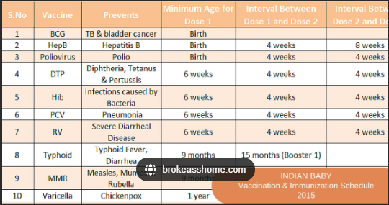
sample data

